Slide 1
Assembly Language for Intel-Based Computers, 4th Edition
Kip R. Irvine
Chapter 14: Disk Fundamentals
Slide show prepared by Kip R. Irvine
Revision date: 08/16/02
Chapter corrections (Web) Assembly language sources (Web)
(c) Pearson Education, 2002. All rights reserved. You may modify and copy this slide show for your personal use, or for use in the classroom, as long as this copyright statement, the author's name, and the title are not changed.

Slide 2
Chapter Overview
Disk Storage Systems
File Systems
Disk Directory
Reading and Writing Disk Sectors (7305h)
System-Level File Functions

Slide 3
Disk Storage Systems
Tracks, Cylinders, and Sectors
Disk Partitions (Volumes)

Slide 4
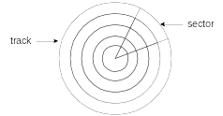
Tracks and Sectors
Physical disk geometry - a way of describing the disk’s structure to make it readable by the system BIOS
Track - concentric circle containing data
Sector - part of a track

Slide 5
Cylinders and Seeking
Cylinder - all tracks readable from one head position
Seek - move read/write heads between tracks

Slide 6
Disk Formatting
Physical formatting
  aka low-level formatting
  Usually done at the factory.
  Must be done before logical formatting
  Defines the tracks, sectors, and cylinders
Logical formatting
  Permits disk to be accessed using sequentially numbered logical sectors
  Installs a file system (ex: NTFS)
  May install an operating system

Slide 7
Fragmentation
A fragmented file is one whose sectors are no longer located in contiguous areas of the disk.
  causes read/write heads to skip
  slower file access
  possible read/write errors

Slide 8
Translation
Translation - conversion of physical disk geometry to a sequence of logical sector numbers
Performed by a hard disk controller (firmware)
Logical sector numbers are numbered sequentially, have no direct mapping to hardware

Slide 9
Disk Partitions
Logical units that divide a physical hard disk
  Also called volumes
Primary partition
  Up to four permitted
  Each may boot a different OS
Extended partition
  Maximum of one permitted
  May be divided into multiple logical partitions, each with a different drive letter
Primary and Extended
  Up to three primary and one extended

Slide 10
Logical Partitions
Created from an extended partition
No limit on the number
Each has a separate drive letter
Usually contain data
Can be bootable (ex: Linux)

Slide 11
Disk Partition Table
Located in the disk's Master Boot Record (MBR), following a block of executable code
Four entries, one for each possible partition
Each entry contains the following fields:
  state (non-active, bootable)
  type of partition (BigDOS, Extended, . . .)
  beginning head, cylinder, & sector numbers
  ending head, cylinder, & sector numbers
  offset of partition from MBR
  number of sectors in the partition
See also: www.datarescue.com/laboratory/partition.htm

Slide 12
Cascading Partition Tables
Primary partition
Drive C
Boot, BigDOS
NA, Extended
NA, BigDOS
Drive D
links to
NA, BigDOS
Drive E
Logical partitions (D, E)
Boot = bootable (system)
NA = non active
BigDOS = over 32 MB

Slide 13
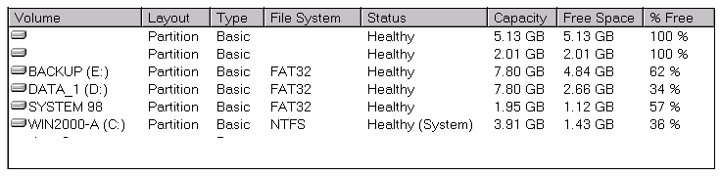
Dual-Boot Example
System 98 and Win2000-A are bootable partitions
  One is called the system partition when active
DATA_1 and BACKUP are logical partitions
  Their data can be shared by both operating systems

Slide 14
Master Boot Record (MBR)
The MBR contains the following elements:
  Disk partititon table
  A program that jumps to the boot sector of the system partition

Slide 15
File Systems
Directory, File, Cluster Relationships
Clusters
FAT12
FAT16
FAT32
NTFS
Primary Disk Areas

Slide 16
File System
This is what it does for you:
  Keeps track of allocated and free space
  Maintains directories and filenames
  Tracks the sector location of each file and directory

Slide 17
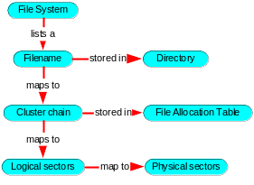
Directory, File, Cluster, Sector Relationships

Slide 18
Cluster (1 of 2)
Smallest unit of space used by a file
Consists of one or more adjacent sectors
Size depends on both the type of file system in use and the disk partition size
A file is a linked sequence of clusters. Example:

Slide 19
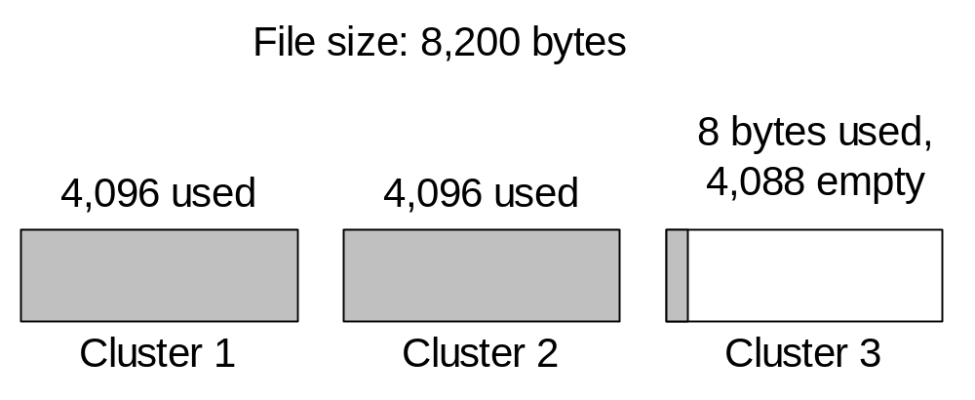
Cluster (2 of 2)
A file always uses at least one cluster
A high percentage of space may be wasted
Example: 8,200-byte file requires three 4K clusters:

Slide 20
FAT12
Designed for diskettes
Each FAT entry is 12 bits
Very little fault tolerance
  two copies of the FAT (cluster table)
Optimal storage for small files
  512-byte clusters

Slide 21
FAT16
MS-DOS format for hard disks
16-bit FAT entries
Large cluster size when disk > 1 GB
  inneficient for small files
Max 2 GB size under MS-DOS
Little or no recovery from read/write errors

Slide 22
FAT32
Supports long filenames
Supported by all version of MS-Windows from Windows 95 onward
  (except Windows NT)
32-bit FAT entries
32 GB maximum volume size
Improved recovery from read/write errors

Slide 23
NTFS
Supported by Windows NT, 2000, and XP
Handles large volumes
  can span multiple hard drives
Efficient cluster size (4K) on large volumes
Unicode filenames
Permissions on files & folders
Share folders across network
Built-in compression and encryption
Track changes in a change journal
Disk quotas for individuals or groups
Robust error recovery
Disk mirroring

Slide 24
Primary Disk Areas
A disk or volume is divided into predefined areas and assigned specific logical sectors.
Example: 1.44 MB diskette
  Boot record (sector 0)
  File allocation table (sectors 1 – 18)
  Root directory (sectors 19 – 32)
  Data area (sectors 33 – 2,879)

Slide 25
Your turn . . .
1. A 1.44 MB diskette has 512 bytes per cluster. Suppose a certain file begins in cluster number 5. Which logical disk sector contains the beginning of the file? (Hint: see page 503).
2. Suppose a certain hard drive has 4 KB per cluster, and we know that the data area begins in sector 100. If a particular file begins in cluster 10, which logical sectors are used by the cluster?
(answers on next panel . . .)

Slide 26
Answers
1. The data area begins in Sector 33 (see page 503). Each cluster = 1 sector, so the file begins in sector 33 + 5 = sector 38.
2. The hard drive has 8 sectors per cluster. The starting cluster number of the file is 100 + (8 * 10) = 180. Therefore, sectors 180 – 187 are used by the file's first cluster.

Slide 27
Boot Record (1 of 2)
Fields in a typical MS-DOS boot record:
  Jump to boot code (JMP instruction)
  Manufacturer name, version number
  Bytes per sector
  Sectors per cluster
  Number of reserved sectors (preceding FAT #1)
  Number of copies of FAT
  Maximum number of root directory entries
  Number of disk sectors for drives under 32 MB
  Media descriptor byte
  Size of FAT, in sectors
  Sectors per track

Slide 28
Boot Record (2 of 2)
(continued)
  Number of drive heads
  Number of hidden sectors
  Number of disk sectors for drives over 32 MB
  Drive number (modified by MS-DOS)
  Reserved
  Extended boot signature (always 29h)
  Volume ID number (binary)
  Volume label
  File-system type (ASCII)
  Start of boot program and data

Slide 29
Keeping Track of Files
MS-DOS Directory Structure
Long Filenames in MS-Windows
File Allocation Table

Slide 30
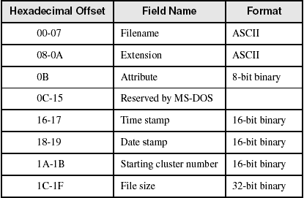
MS-DOS Directory Structure (1 of 2)

Slide 31

MS-DOS Directory Structure (2 of 2)
Time field equals 4DBDh (9:45:58), and the Date field equals 247Ah (March 26, 1998). Attribute is normal:

Slide 32
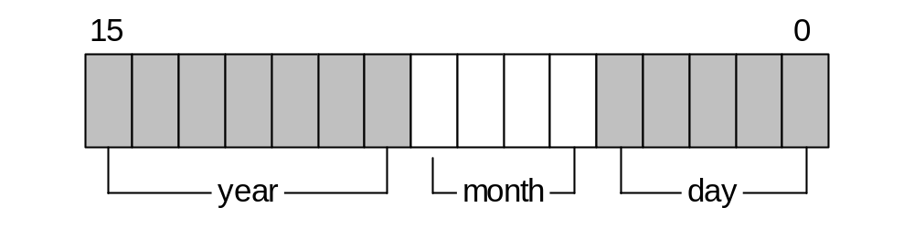
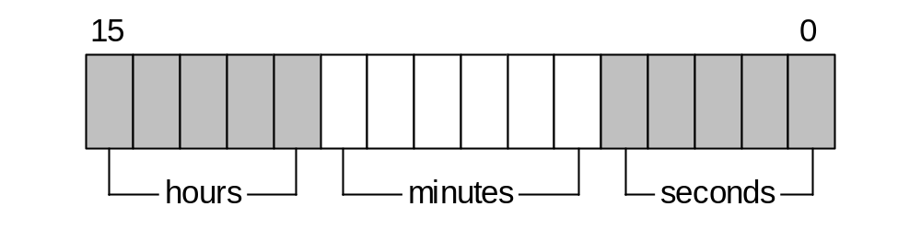
Date and Time Fields
Date stamp field:
Time stamp field:

Slide 33
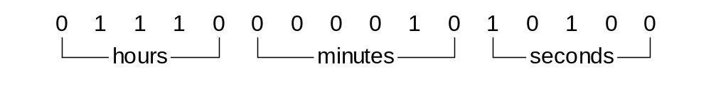
Your turn . . .
What time value is represented here?

Slide 34
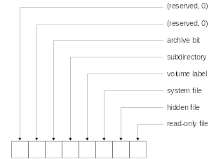
File Attribute Values
What type of file has attribute 00100111 . . . ?

Slide 35
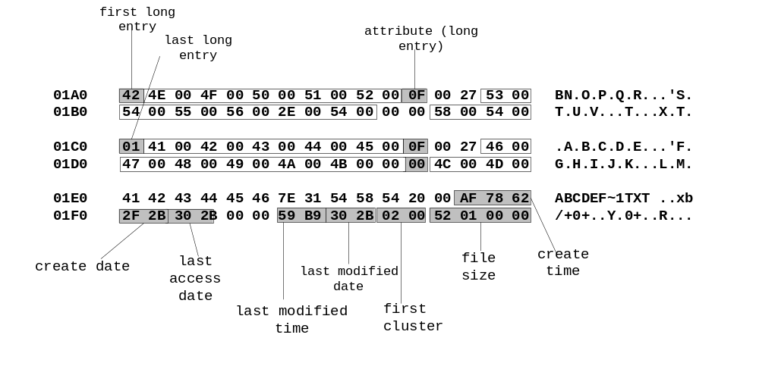
Long Filenames in MS-Windows
Filename: ABCDEFGHIJKLMNOPQRSTUV.TXT

Slide 36
File Allocation Table (1 of 2)
A map of all clusters on the disk, showing their ownership by specific files
Each entry corresponds to a cluster number
Each cluster contains one or more sectors
Each file is represented in the FAT as a linked list, called a cluster chain.
Three types of FAT's, named after the length of each FAT entry:
  FAT-12
  FAT-16
  FAT-32

Slide 37
File Allocation Table (2 of 2)
Each entry contains an n-bit integer that identifies the next entry. (n=12,16, or 32)
Two cluster chains are shown in the following diagram, one for File1, and another for File2:

Slide 38
Reading and Writing Disk Sectors (7305h)
INT 21h, Function 7305h (absolute disk read and write)
Reads and writes logical disk sectors
Runs only in 16-bit Real-address mode
Does not work under Windows NT, 2000, or XP
  Tight security!

Slide 39
DISKIO Structure
Used by Function 7305h:
DISKIO STRUCT
startSector DWORD 0 ; starting sector number
numSectors WORD 1 ; number of sectors
bufferOfs WORD buffer ; buffer offset
bufferSeg WORD @DATA ; buffer segment
DISKIO ENDS

Slide 40
Example
Example: Read one or more sectors from drive C:
.data
buffer BYTE 512 DUP(?)
diskStruct DISKIO <>
.code
mov ax,7305h ; absolute Read/Write
mov cx,0FFFFh ; always this value
mov dl,3 ; drive C
mov bx,OFFSET diskStruct
mov si,0 ; read sector
int 21h

Slide 41
Sector Display Program
Pseudocode:
  Ask for starting sector number and drive number
  do while (keystroke <> ESC)
  Display heading
  Read one sector
  If MS-DOS error then exit
  Display one sector
  Wait for keystroke
  Increment sector number
  end do
View the source code

Slide 42
System-Level File Functions
Common Disk-Related Functions
Get Disk Free Space
Create Subdirectory
Remove Subdirecrory
Set Current Directory
Get Current Directory

Slide 43
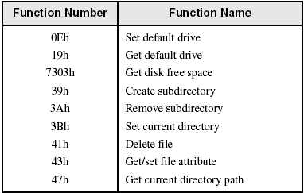
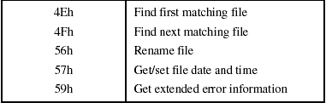
Common Disk-Related Functions

Slide 44
ExtGetDskFreSpcStruc Structure (1 of 2)
Structure data returned by Fucntion 7303h:
StructSize: A return value that represents the size of the ExtGetDskFreSpcStruc structure, in bytes.
Level: Always 0.
SectorsPerCluster: The number of sectors inside each cluster.
BytesPerSector: The number of bytes in each sector.
AvailableClusters: The number of available clusters.
TotalClusters: The total number of clusters in the volume.

Slide 45
ExtGetDskFreSpcStruc (2 of 2)
AvailablePhysSectors: The number of physical sectors available in the volume, without adjustment for compression.
TotalPhysSectors: The total number of physical sectors in the volume, without adjustment for compression.
AvailableAllocationUnits: The number of available allocation units in the volume, without adjustment for compression.
TotalAllocationUnits: The total number of allocation units in the volume, without adjustment for compression.
Rsvd: Reserved member.

Slide 46
Function 7303h – Get Disk Free Space
AX = 7303h
ES:DI points to a ExtGetDskFreSpcStruc
CX = size of the ExtGetDskFreSpcStruc variable
DS:DX points to a null-terminated string containing the drive name
View the DiskSpc.asm program

Slide 47
Create Subdirectory
.data
pathname BYTE "\ASM",0
.code
mov ah,39h ; create subdirectory
mov dx,OFFSET pathname
int 21h
jc DisplayError
.
.
DisplayError:

Slide 48
Remove Subdirecrory
.data
pathname BYTE 'C:\ASM',0
.code
mov ah,3Ah ; remove subdirectory
mov dx,OFFSET pathname
int 21h
jc DisplayError
.
.
DisplayError:

Slide 49
Set Current Directory
.data
pathname BYTE "C:\ASM\PROGS",0
.code
mov ah,3Bh ; set current directory
mov dx,OFFSET pathname
int 21h
jc DisplayError
.
.
DisplayError:

Slide 50
Get Current Directory
.data
pathname BYTE 64 dup(0) ; path stored here by MS-DOS
.code
mov ah,47h ; get current directory path
mov dl,0 ; on default drive
mov si,OFFSET pathname
int 21h
jc DisplayError
.
.
DisplayError:

Slide 51
Your turn . . .
Write a program that creates a hidden, read-only directory named __secret. Create a hidden file inside the new directory named $$temp. Try to remove the directory by calling Function 3Ah. Display the error code returned by MS-DOS.

Slide 52

The End

Slide 53
text
code

Slide 54
output window
syntax
code

